Slide 1
CELEBAL SUMMER INTERNSHIP

Slide 2
Team Contributors
Project: Neha Dutta
Presentation: Ayushi Agrawal
Divy Sharma
Report: Badal Singh Rathore
Sukhvir Singh

Slide 3
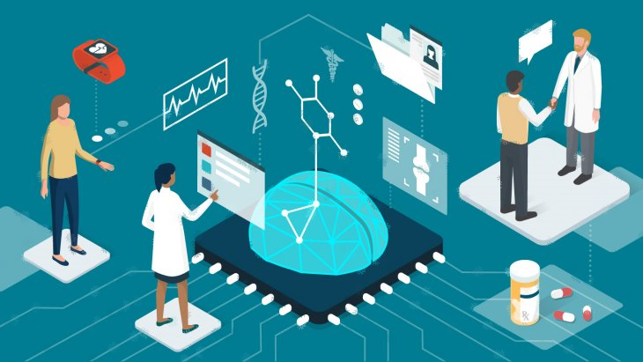
Project title
Enhancing Medical Diagnosis through Advanced Machine Learning: A Personalized Approach for Timely Treatments
Enhancing Medical Diagnosis through Advanced Machine Learning: A Personalized Approach for Timely Treatments

Slide 4
Problem statement
Develop a machine learning model to diagnose medical conditions based on patient symptoms, test results, and medical history, aiming to assist doctors in making accurate and timely diagnoses.

Slide 5
What is Medical Diagnosis
Medical diagnosis is the process of identifying a specific disease, health condition, or ailment that a patient is experiencing.
It involves gathering and analyzing relevant information, such as symptoms, medical history, and test results.
Healthcare professionals use their clinical expertise, medical knowledge, and diagnostic tools to make an accurate diagnosis, which is crucial for determining the appropriate treatment and care plan to improve the patient's health.

Slide 6
Role of ML in Medical Diagnosis
Machine learning revolutionizes medical diagnosis by analyzing large datasets comprising patient symptoms, medical history, and test results.
Its ability to uncover hidden patterns and correlations aids in accurate and early detection of diseases.
Studies demonstrate machine learning's success in various medical fields, such as dermatology, radiology, and cardiology, with models achieving up to 98% accuracy in certain cases (source: Nature, JAMA Dermatology).
It empowers healthcare professionals with powerful diagnostic support, leading to improved patient outcomes and personalized treatments.

Slide 7
Steps involved in ML approach
Data Collection: Gather diverse and comprehensive datasets containing patient symptoms, medical history, and test results from various sources.
Data Preprocessing: Cleanse, normalize, and handle missing values in the data to ensure its quality and consistency.
Feature Selection/Extraction: Identify relevant features or create new ones to represent patient information effectively.
Model Selection: Choose appropriate machine learning algorithms (e.g., decision trees, random forests, neural networks) for medical diagnosis.
Model Training: Train the selected model using the preprocessed data.
Model Evaluation: Assess the model's performance using metrics like accuracy, precision, recall, and F1-score.
Model Optimization: Fine-tune the model's hyperparameters to improve its diagnostic accuracy.
Deployment: Implement the trained model into a user-friendly application for medical professionals' use.
Continuous Learning: Periodically update the model with new data to keep it relevant and accurate.

Slide 8
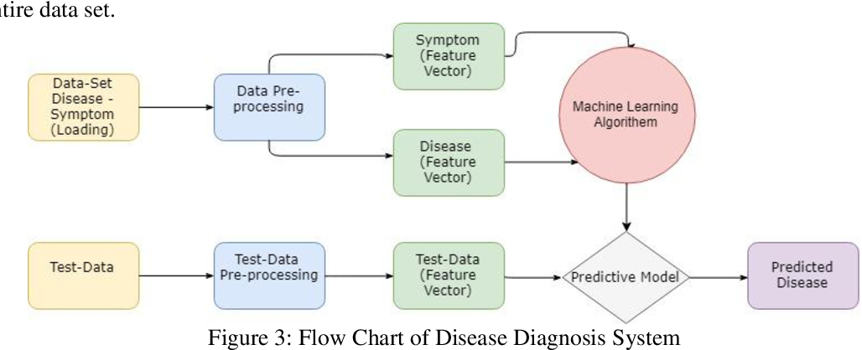
Flow Chart of ML approach

Slide 9
Data Collection and Preprocessing
Collecting diverse datasets containing patient symptoms, medical history, and test results.
About dataset:
Dataset contains details of patient such as, Age, Sex, education, current smoker, cigs per day, bp meds, prevalent stroke Prevalent hyp, diabetes, tot chol, sys bp, dia bp, bmi heart rate, glucose, and 10 year risk of coronary heart disease CHD.
Preprocessing steps:
Data cleansing and handling missing values to ensure data quality. Identify relevant features or create new ones to represent patient information effectively.

Slide 10
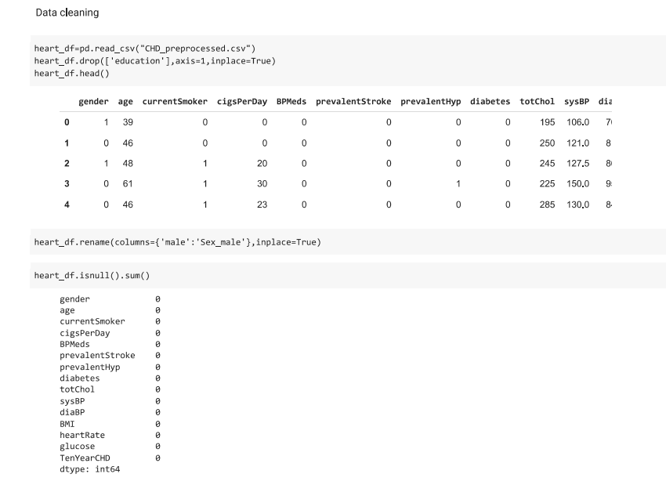
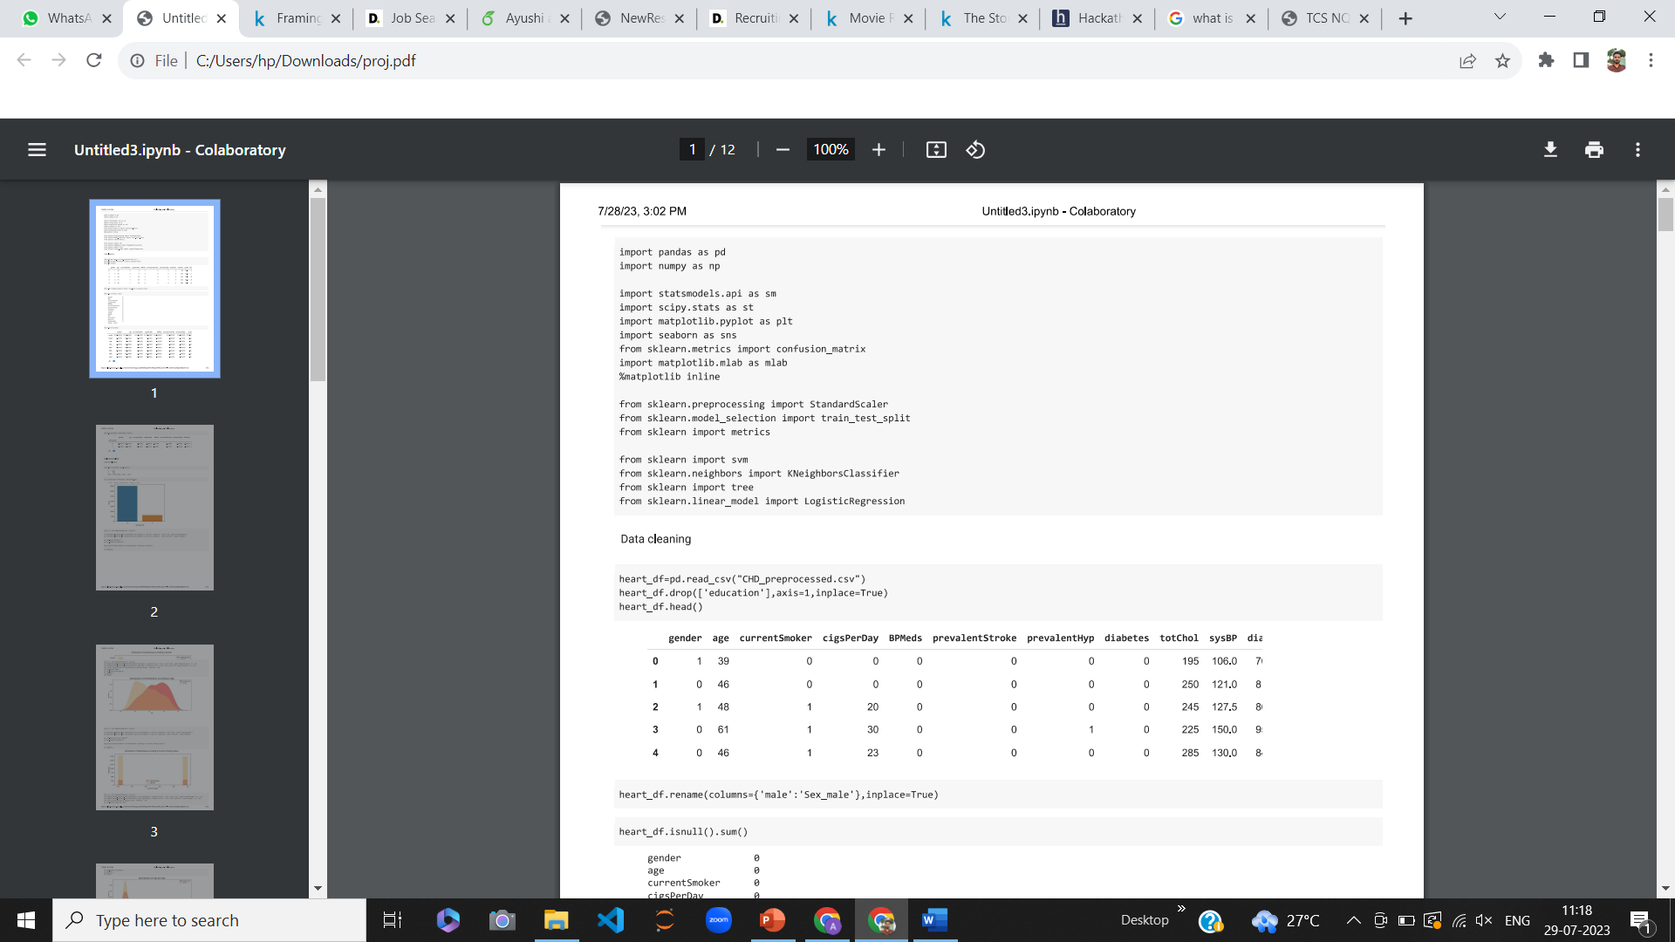

Slide 11
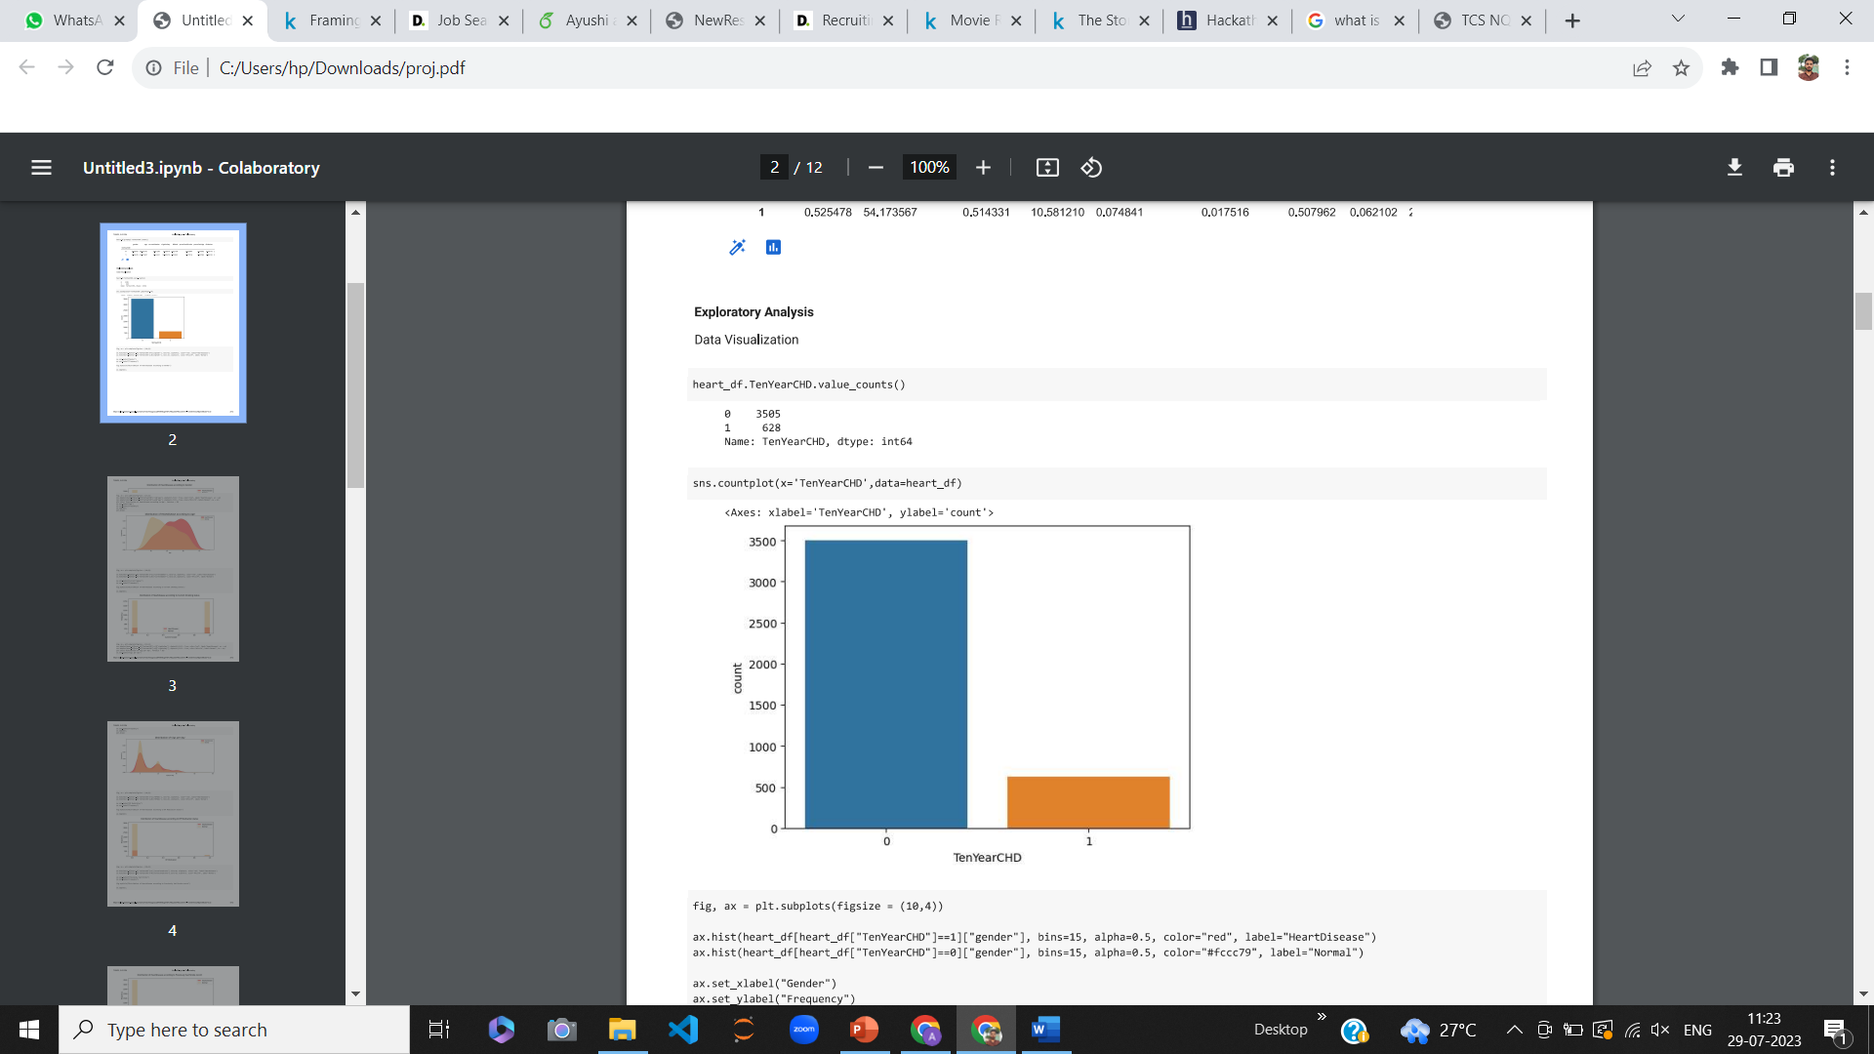
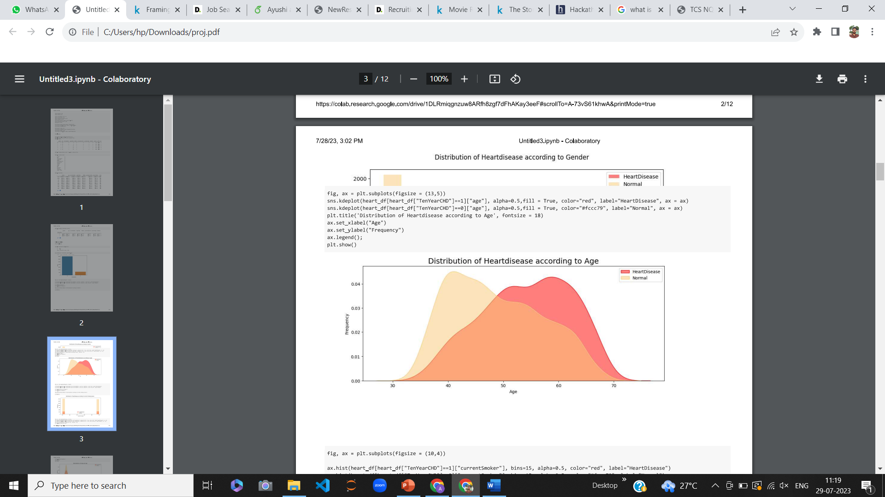
DATA VISUALIZATION

Slide 12
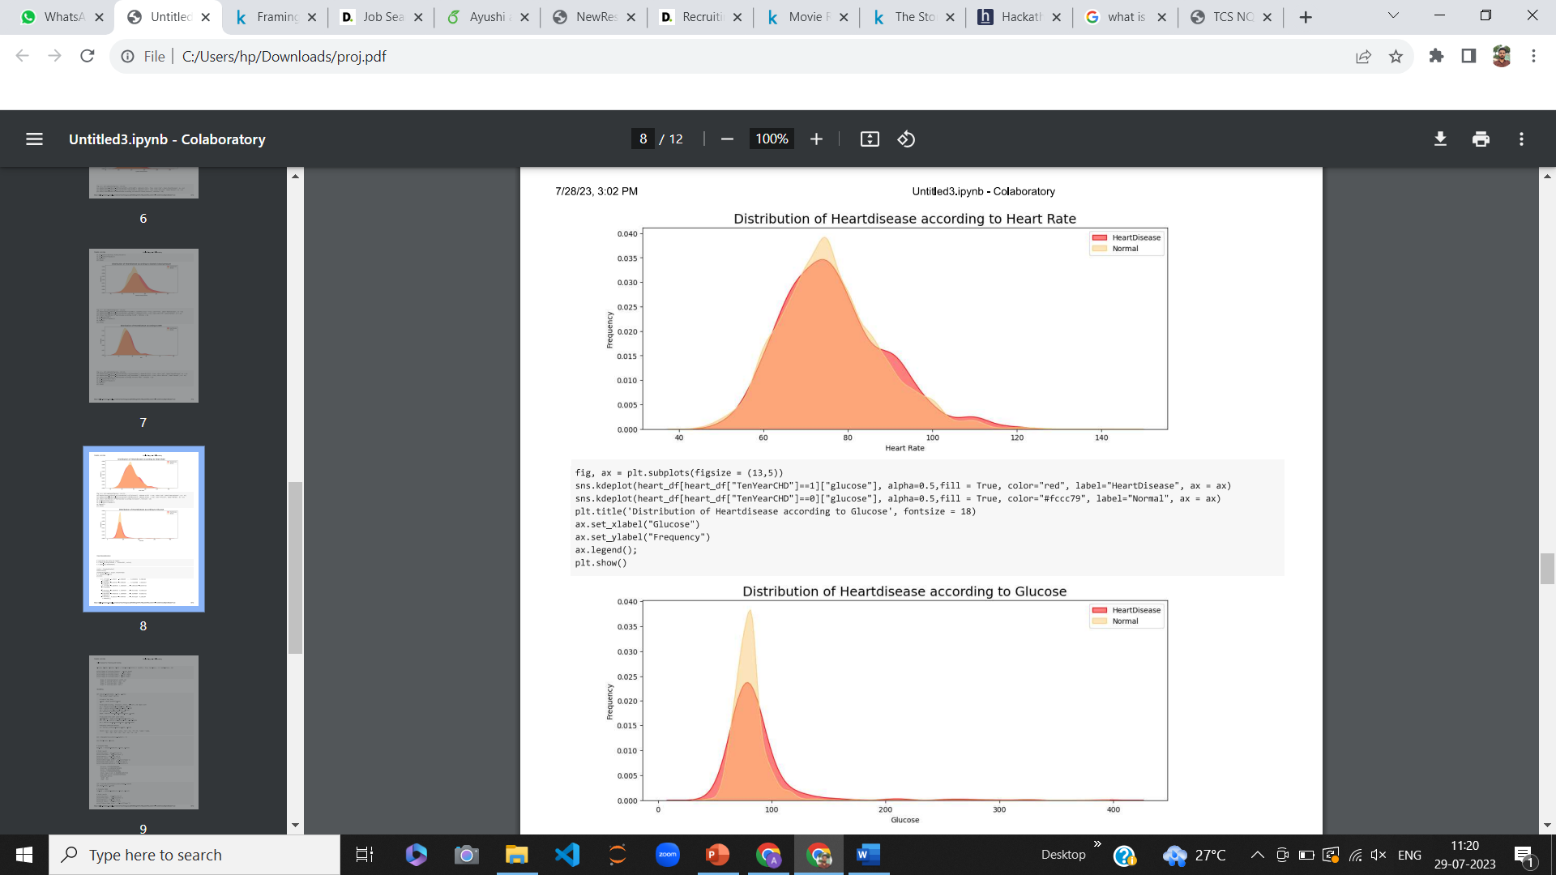

Slide 13
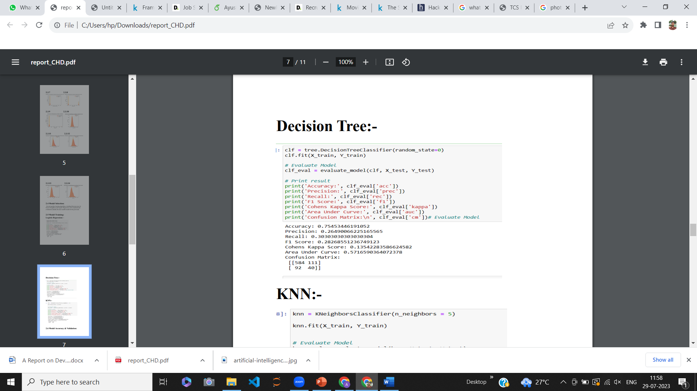
Model Selection
Choose appropriate machine learning algorithms (e.g., Decision trees, Logistic Regression, and KNN ) for medical diagnosis.
1. Decision tree

Slide 14
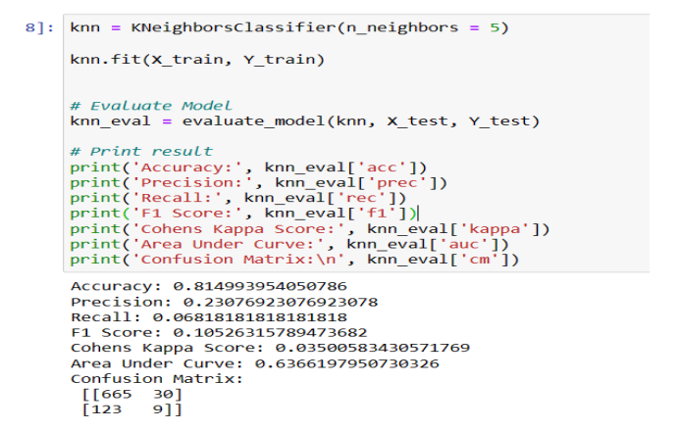
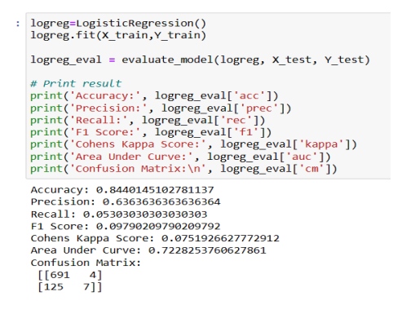
2. K Nearest Neighbor(KNN)
3. Logistic Regression

Slide 15
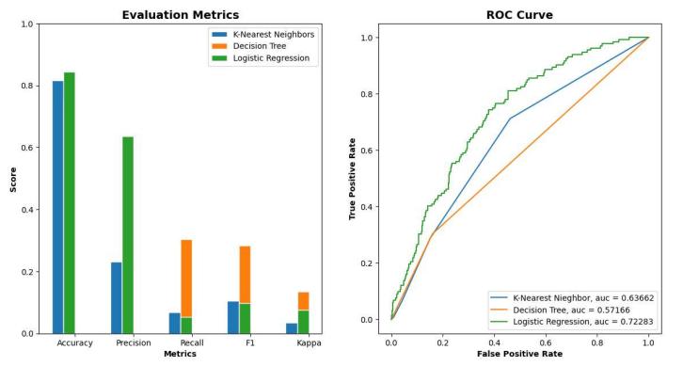
Model Evaluation
Assess the model's performance using metrics like accuracy, precision, recall, ROC Curve, and F1-score.

Slide 16
Looking at the comparative study of the accuracy of 3 different machine learning algorithm, Logistics Regression model happens to have the highest accuracy of 84.4%.
In our problem statement, Logistic Regression follows the principle of Occam’s Razor, which defines that for a particular problem statement, if the data has no assumption, then the simplest model works the best. Since our dataset does not have any assumptions and Logistic Regression is a simple model. Therefore, the concept holds true for the above-mentioned dataset.

Slide 17
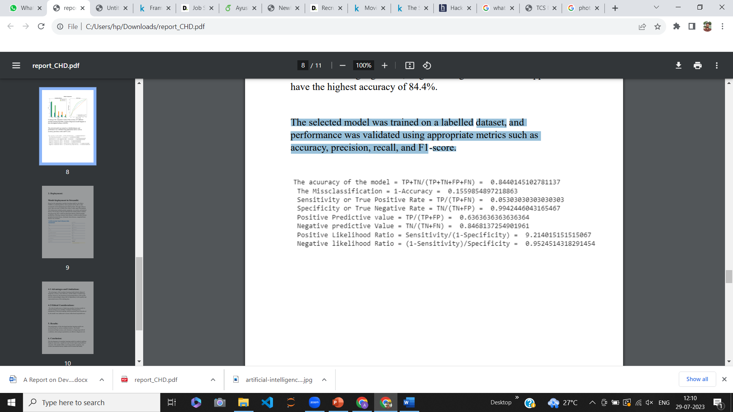
Model Training
The selected model was trained on a labelled dataset, and performance was validated using appropriate metrics such as accuracy, precision, recall, and F1-score.

Slide 18
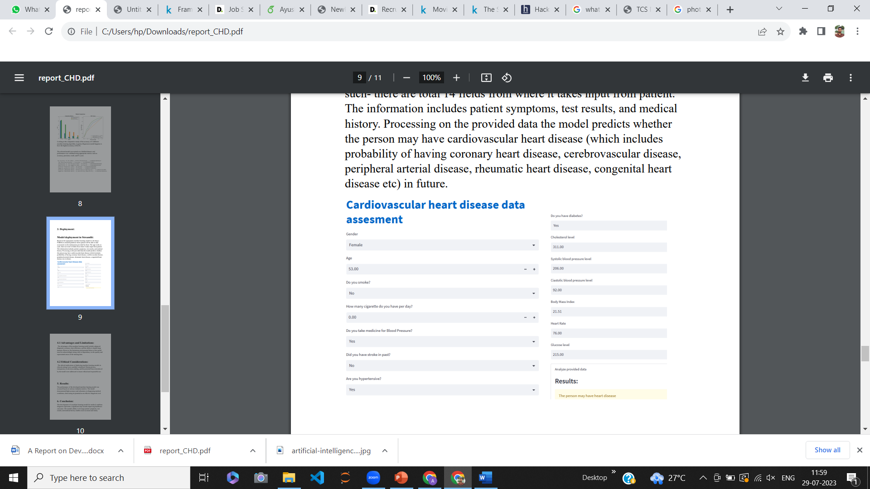
Deployment
Based on the appropriate machine learning model we develop a FORM on streamlit platform where patient will be able to take assessment on the information provided by them.

Slide 19
Results and Impact
Model performance evaluation results in deciding Linear regression as the best model with an accuracy score of 84%.
Impacts:
Enhanced Diagnostic Accuracy: Improved precision in identifying medical conditions through pattern analysis.
Personalized Treatment Plans: Tailored interventions based on accurate diagnoses.
Improved Patient Outcomes: Timely, precise diagnoses lead to better healthcare results and increased patient satisfaction.

Slide 20
Continuous learning & updates
Model evolves with new patients data.
Periodic retraining for improved accuracy.
Retains past knowledge while integrating new trends.
Seamless updates for medical professionals.

Slide 21
Conclusion
In conclusion, the development of our innovative machine learning model has showcased its potential in revolutionizing medical diagnoses.
By leveraging patient symptoms, medical history, and test results, we have achieved enhanced diagnostic accuracy and personalized treatment plans.
The impact on patient outcomes and healthcare efficiency has been significant, setting a promising path for the future of precision medicine.
This project highlights the power of technology in transforming healthcare, ultimately benefiting patients and medical professionals alike.

Slide 22
Thank you!

